Slide 1
KimchiC0n Badge

Slide 2
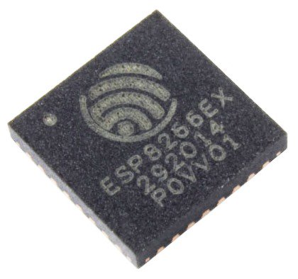
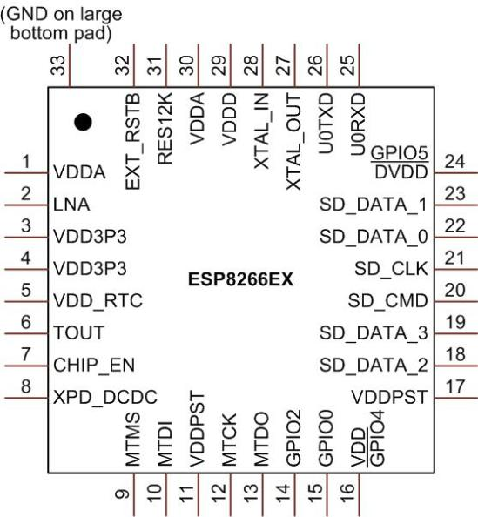
ESP8266
저가 wifi 칩 – very low price ($1-$2) - WiFi SOC
Full TCP/IP stack + MCU (32-bit RISC: Tensilica Xtensa L 106 at 80 MHz) - AP/STA dual mode 지원 – wifi 게이트웨이로 동작 가능함
Produced by Shanghai-based Chinese manufacturer, Espressif Systems
16 GPIO/SPI/I2C/UART/ADC/etc…

Slide 3
SDKs
NodeMCU – a Lua-based firmware
Arduino – C++ based firmware – ESP8266 Arduino Core
MicroPython
ESP8266 BASIC
Zbasic for ESP8266
Espruino
Mongoose Firmware
ESP-Open-SDK
ESP-Open-RTOS

Slide 4
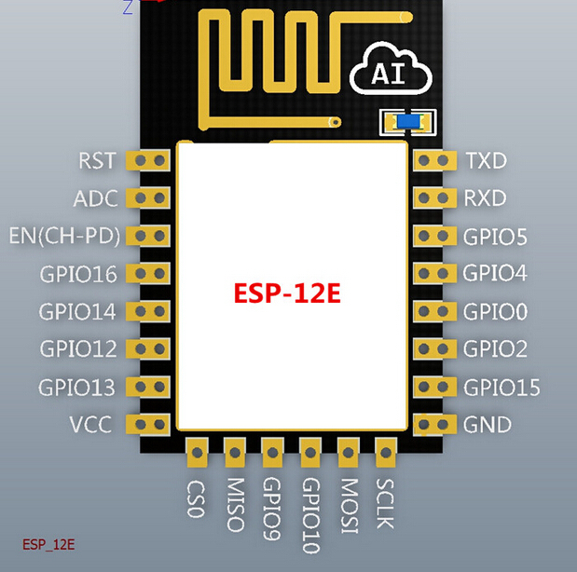
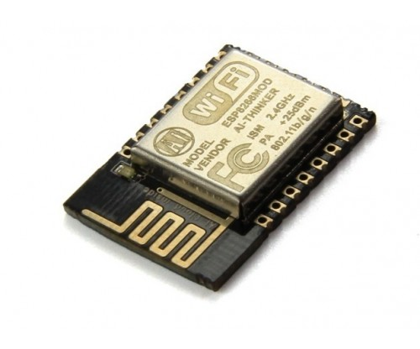
AI-Thinker modules
AI-Thinker: 3rd party manufacturer
ESP-01 ~ ESP-14

Slide 5
Boards – 더 복잡한 보드들
ESP8266 + USB-to-UART + Micro-USB + 3.3 volt regulator
개발을 위한 최적의 환경 – 자잘한 칩/보드의 사양에 신경 쓰지 않아도 됨
ESP-12E 모듈에 기반해서 만들어진 경우가 많음
Bolt IoT, Olimex, NodeMCU DEVKIT, Adafruit Huzzah ESP8266 breakout, SparkFun ESP8266 Thing, KNEWRON Technologies smartWIFI, WeMos D1, WeMos D1 R2, WeMos D1 mini, WeMos D1 mini Lite, WeMos D1 mini Pro, ESPert ESPresso Lite, ESPert ESPresso Lite V2.0, In-Circuit ESP-ADC, Watterott ESP-WROOM02-Breakout, Geek wave solution IOT_WROOM-02 based WIFI development board

Slide 6
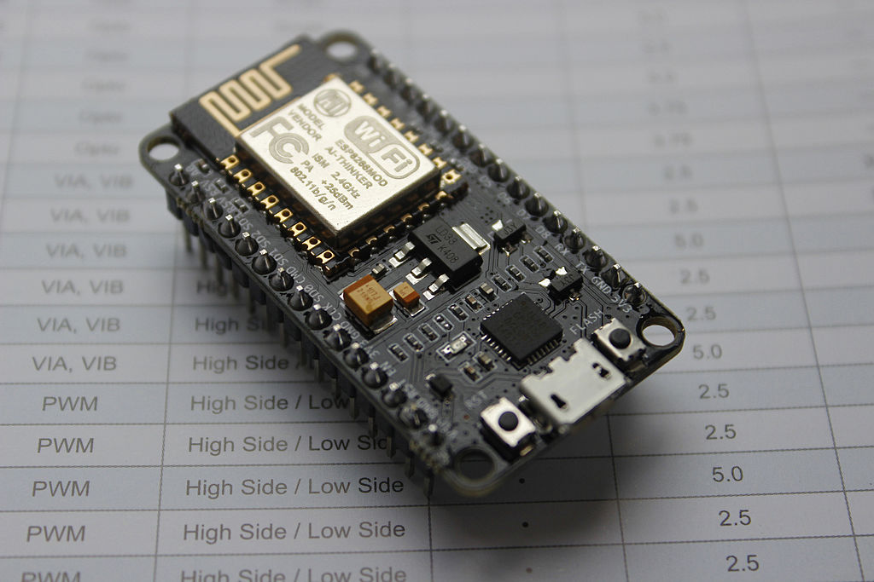
NodeMCU
NodeMCU == SDK & firmware (https://github.com/nodemcu/nodemcu-firmware)
lua based interactive firmware for mcu like esp8266
http://nodemcu.com/
NodeMCU Dev Kits == open source board name (https://github.com/nodemcu/nodemcu-devkit-v1.0 )

Slide 7
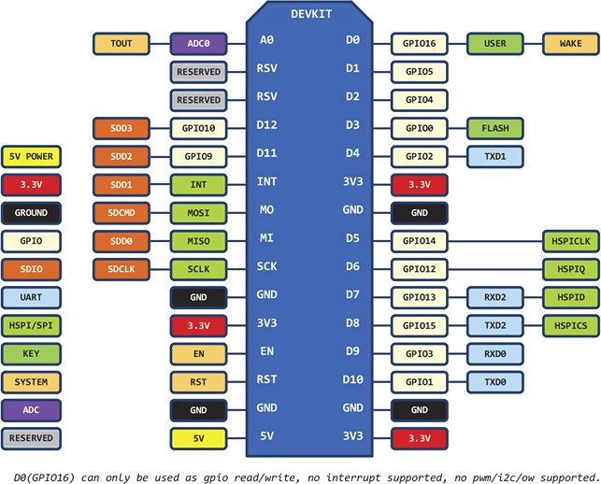
NodeMCU dev kit v3 pin map –

Slide 8
NodeMCU Firmware
Firmware code/builds
Source code - https://github.com/nodemcu/nodemcu-firmware
Custom builds – http://Nodemcu-build.com
Firmware flasher (ESP-general)
Esptool – Official flasher from Espressif - https://github.com/espressif/esptool
NodeMCU Flasher – GUI tool - https://github.com/nodemcu/nodemcu-flasher
NodeMCU pyFlasher – Python-based + GUI - https://github.com/marcelstoer/nodemcu-pyflasher

Slide 9
Development Environment
Arduino IDE
Esplorer - https://esp8266.ru/esplorer/ - Lua/MicroPython
SDk Documentation - https://nodemcu.readthedocs.io/en/master/

Slide 10
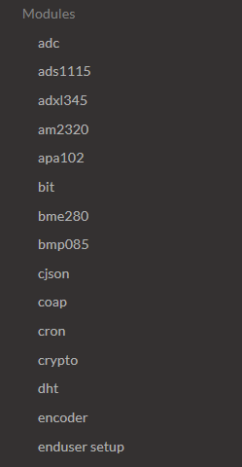
Firmware 선택하기
어떠한 기능을 사용할지에 대한 결정 – SDK documentation 의 modules 참조
Module을 사용하기 위해서는 firmware build에 포함 되어 있어야 함.
ex) http://Nodemcu-build.com
Flash – use flash tools
ex) NodeMCU pyFlasher – Python-based + GUI - https://github.com/marcelstoer/nodemcu-pyflasher

Slide 11
KimchiC0n Badge 보드/개발
Board: NodeMCU v3
Firmware: file, gpio, http, i2c, net, node, spi, tmr, u8g, uart, websocket, wifi, ws2812
NodeMCU pyFlasher – Python-based + GUI - https://github.com/marcelstoer/nodemcu-pyflasher
Prerequisites: wxPython/PySerial
Esplorer - https://esp8266.ru/esplorer/ - Lua/MicroPython
Prerequisites: JRE

Slide 12
개발 패키지 묶음
https://www.dropbox.com/s/0ka9hyoab2hdcau/KimchiC0n.zip?dl=0
NodeMCU-PyFlasher-1.0.1.exe 실행
NodeMCU를 USB 포트에 연결후 COM 포트 확인
다음 펌웨어 선택후 플래슁
nodemcu-master-13-modules-2017-06-29-01-41-27-float.bin
개발 환경 – ESPlorer 실행

Slide 13
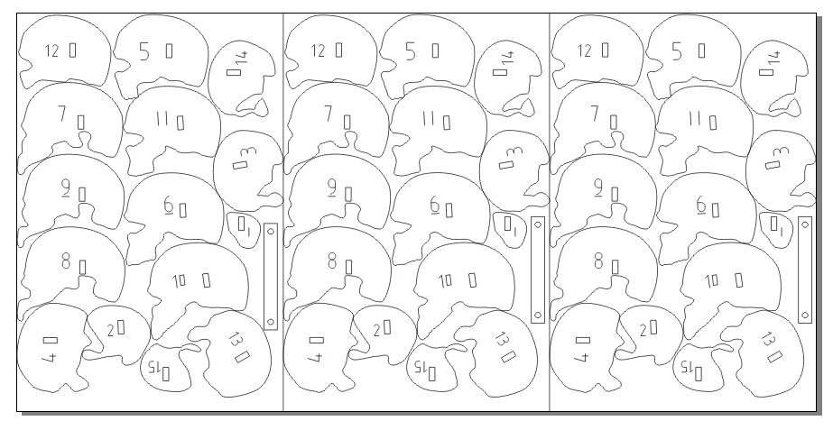
해골

Slide 14
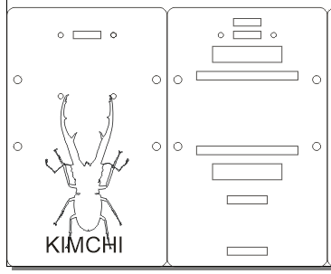
케이스

Slide 15
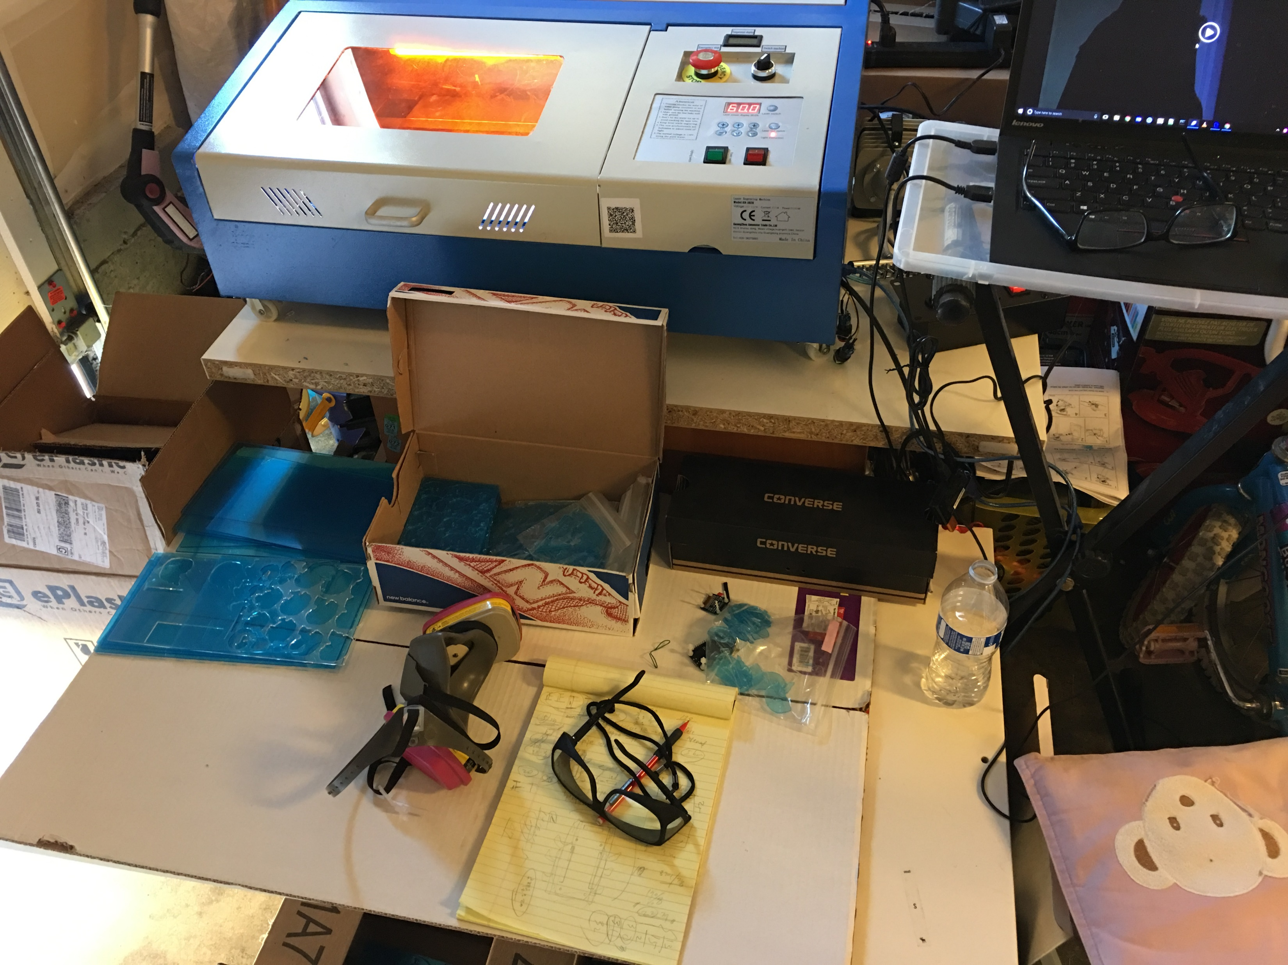
레이저 커팅 – CO2 laser cutter – ebay $400

Slide 16
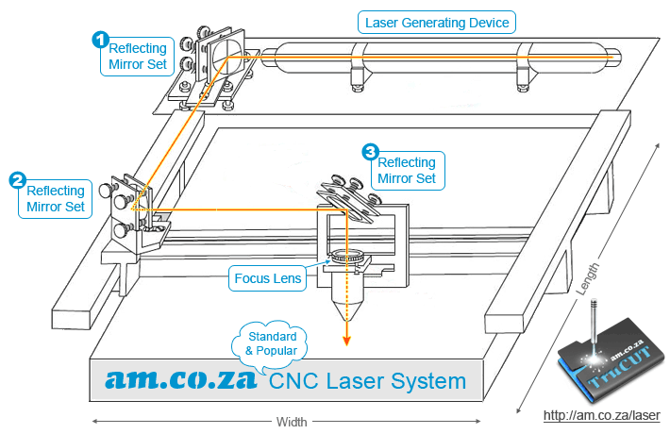
Laser Cutter Concept

Slide 17
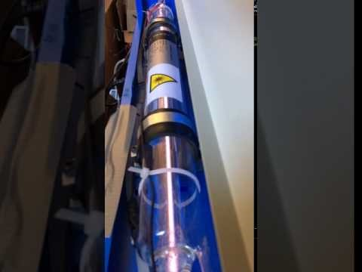
레이저 커팅 – Laser Tube

Slide 18
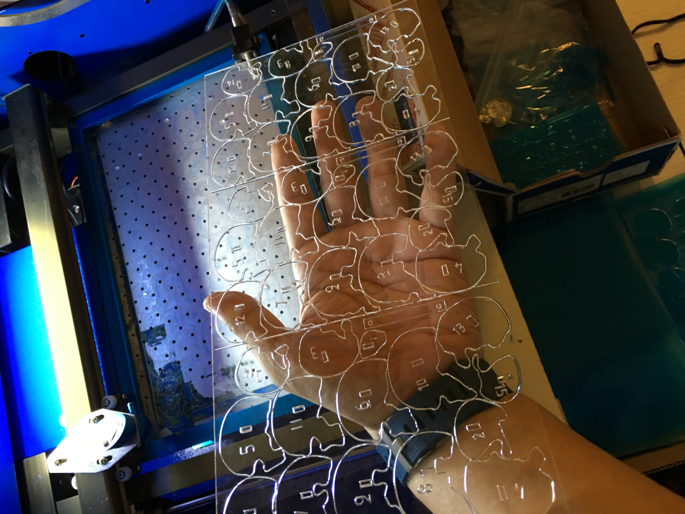
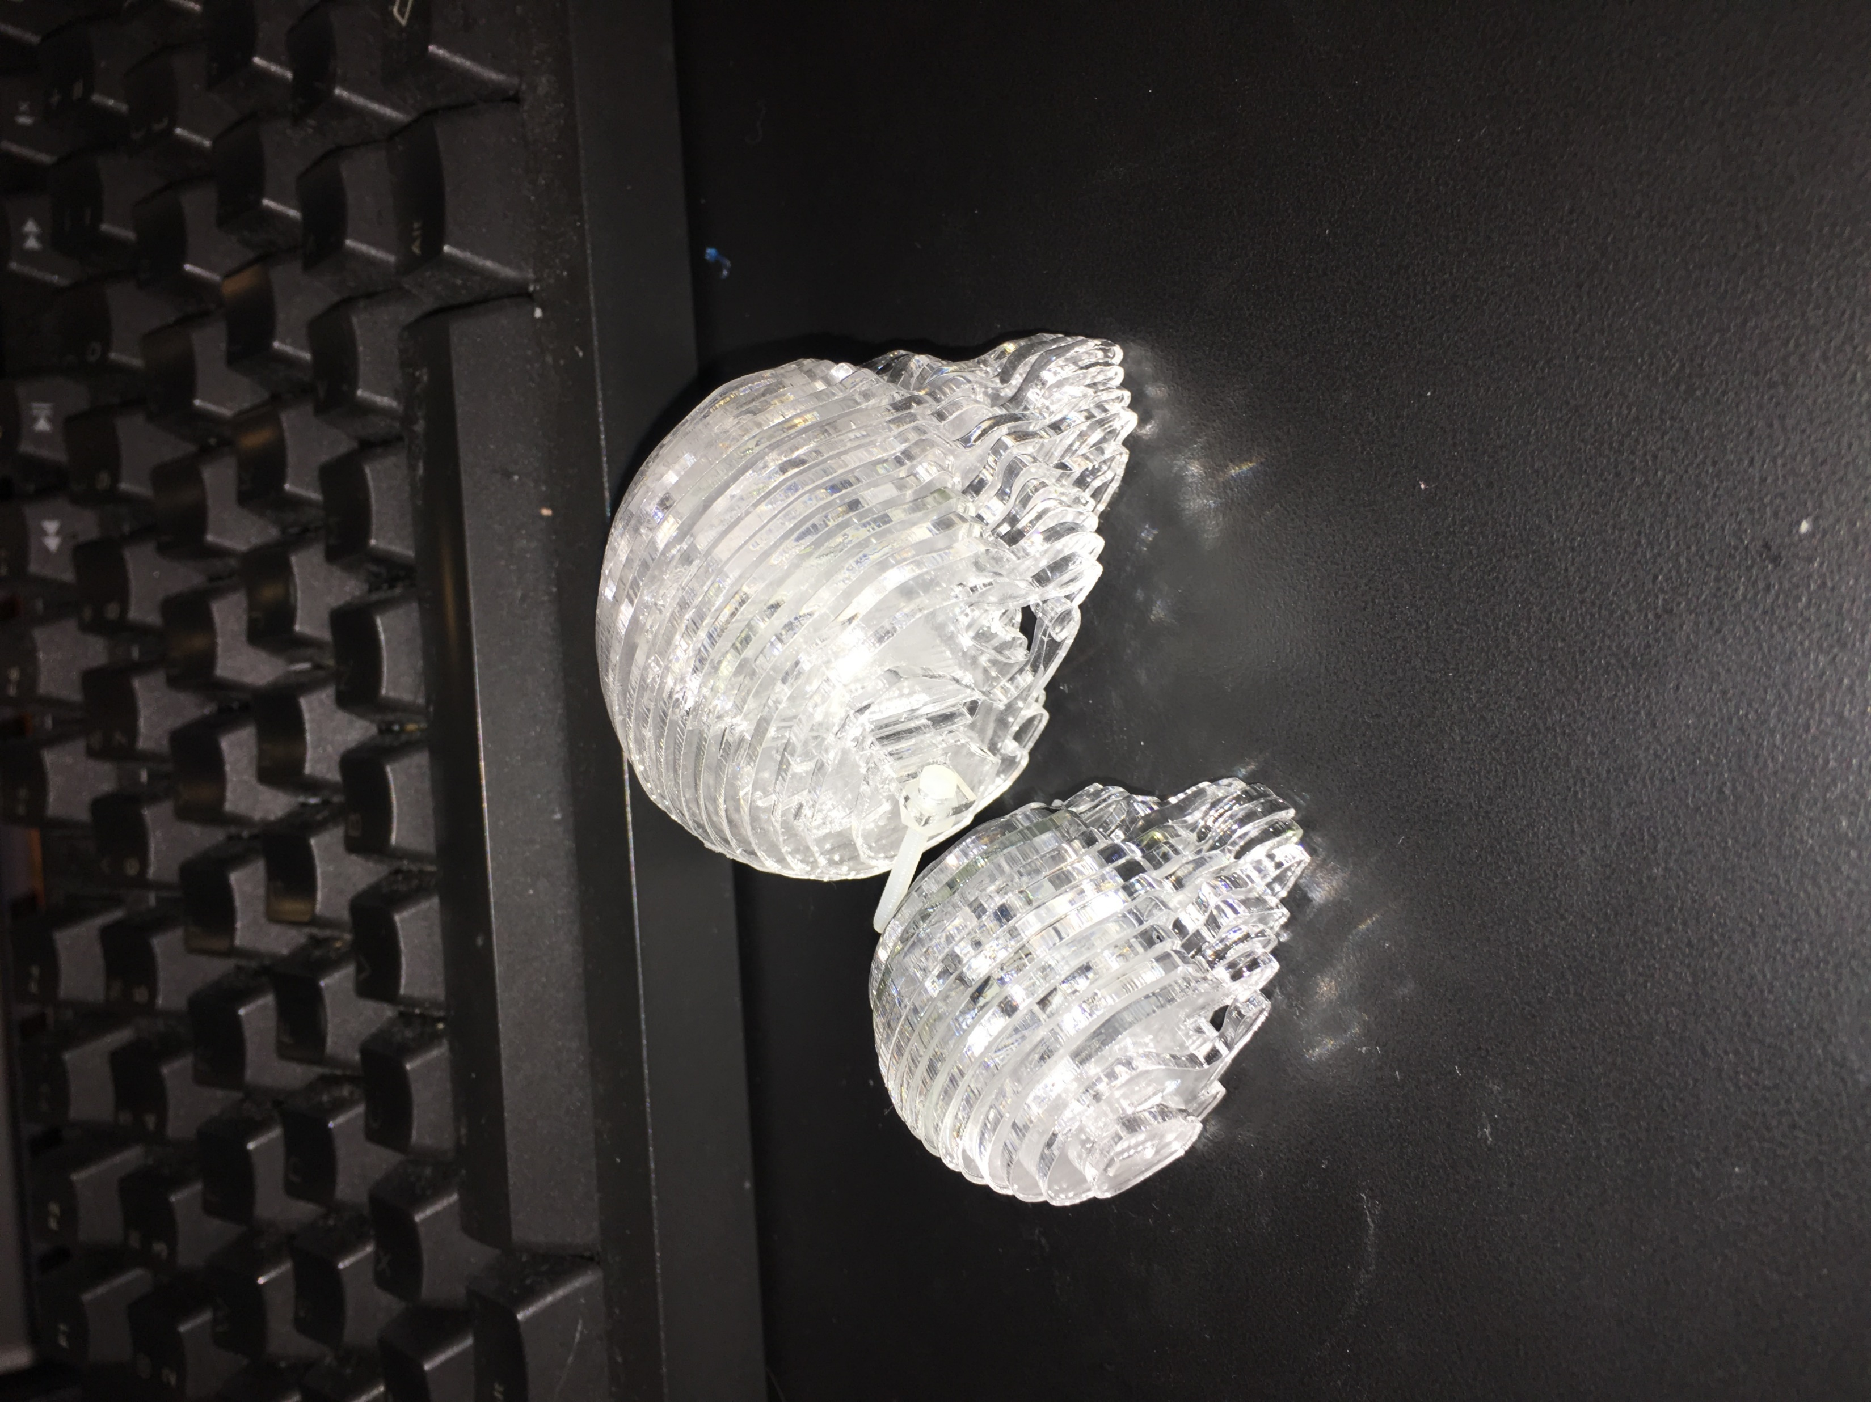
레이저 커팅

Slide 19
뱃지 조립하기
앞판 + 뒷판 + NodeMCU: 큰 bolts x 4 /nuts x 12
앞판 + OLED: 작은 bolts x 2 /nuts x 4
해골: 작은 bolts x 2 /nuts x 4

Slide 20
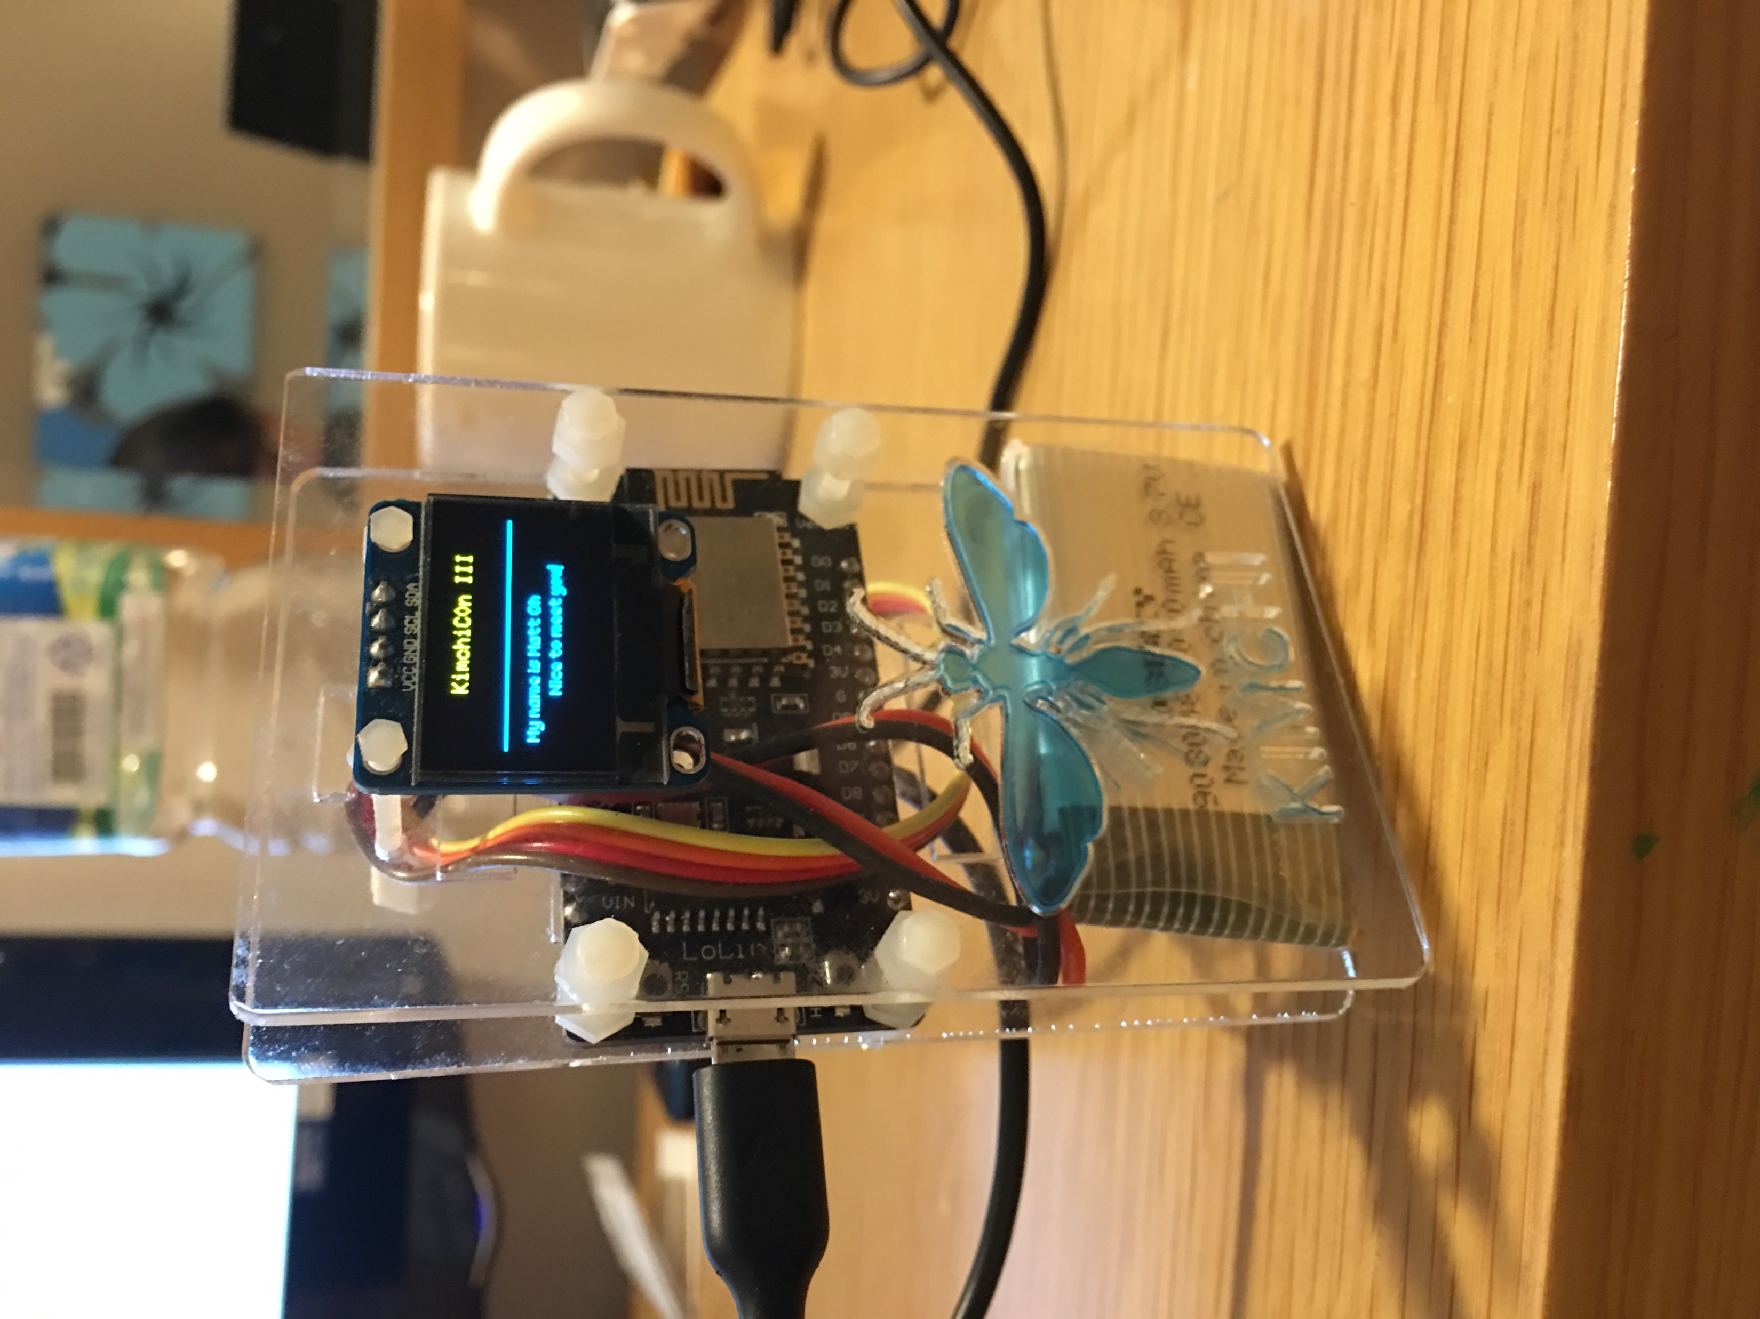
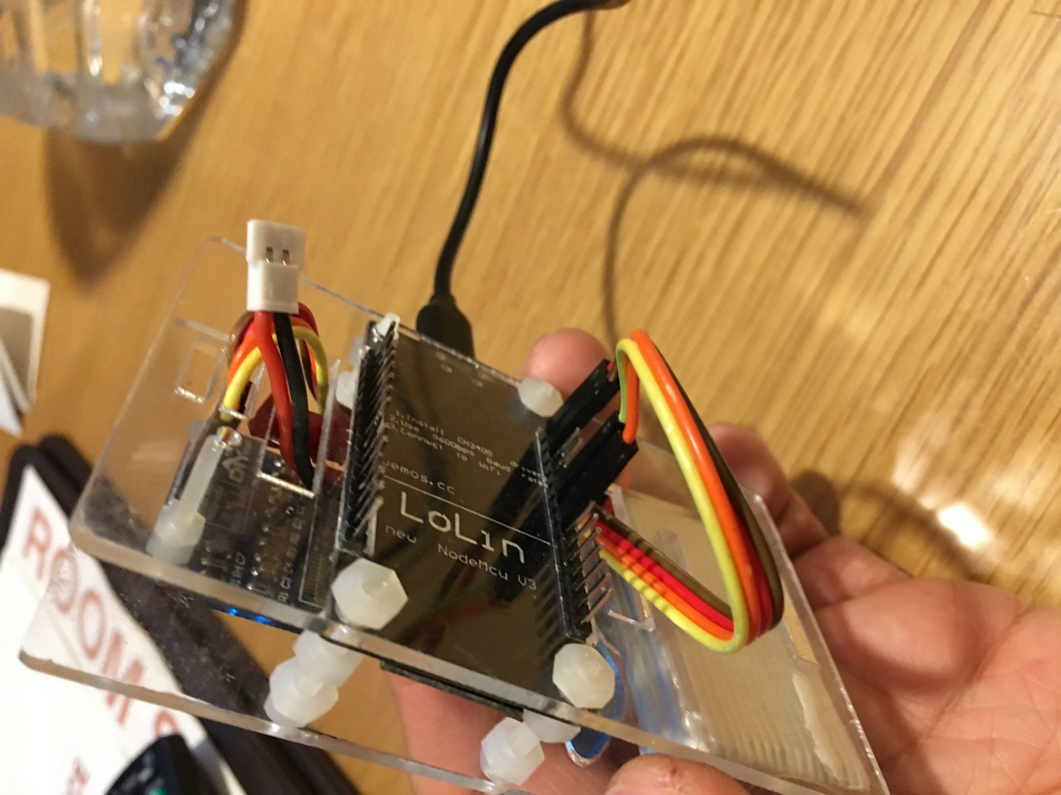
KimchiC0n 3 - DIY

Slide 21
Badge Pinmap - OLED
NodeMCU | OLED
3V | VCC
G | GND
D5 | SCL
D7 | SDA

Slide 22
Badge Pinmap – LED strip
NodeMCU | LED Strip
GND | GND
D4 | DIN
3V | VCC

Slide 23
Badge Pinmap - Power
NodeMCU | Battery
3V | VCC - Red
G | GND - Black

Slide 24
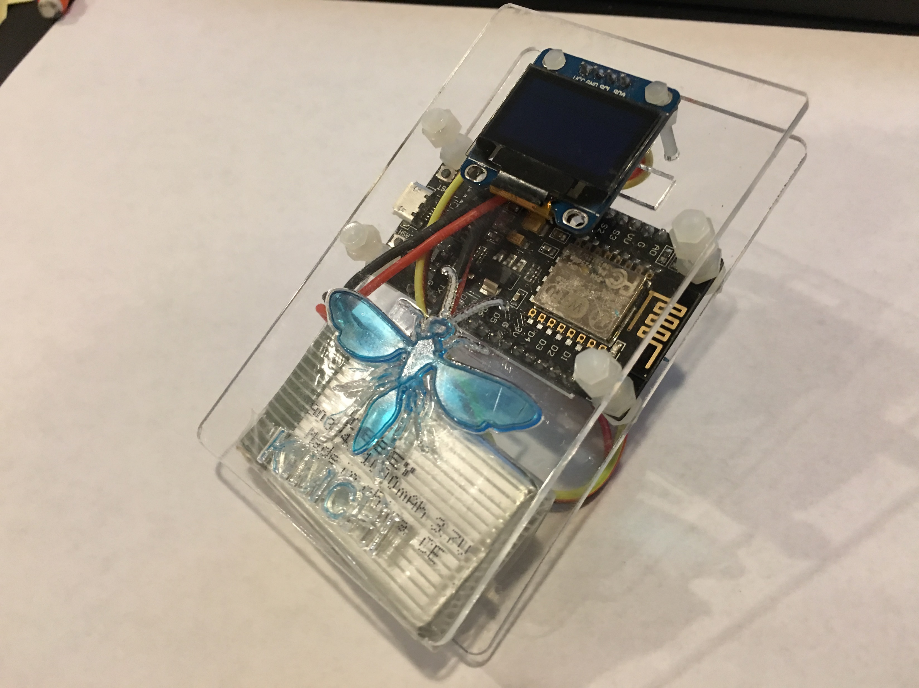
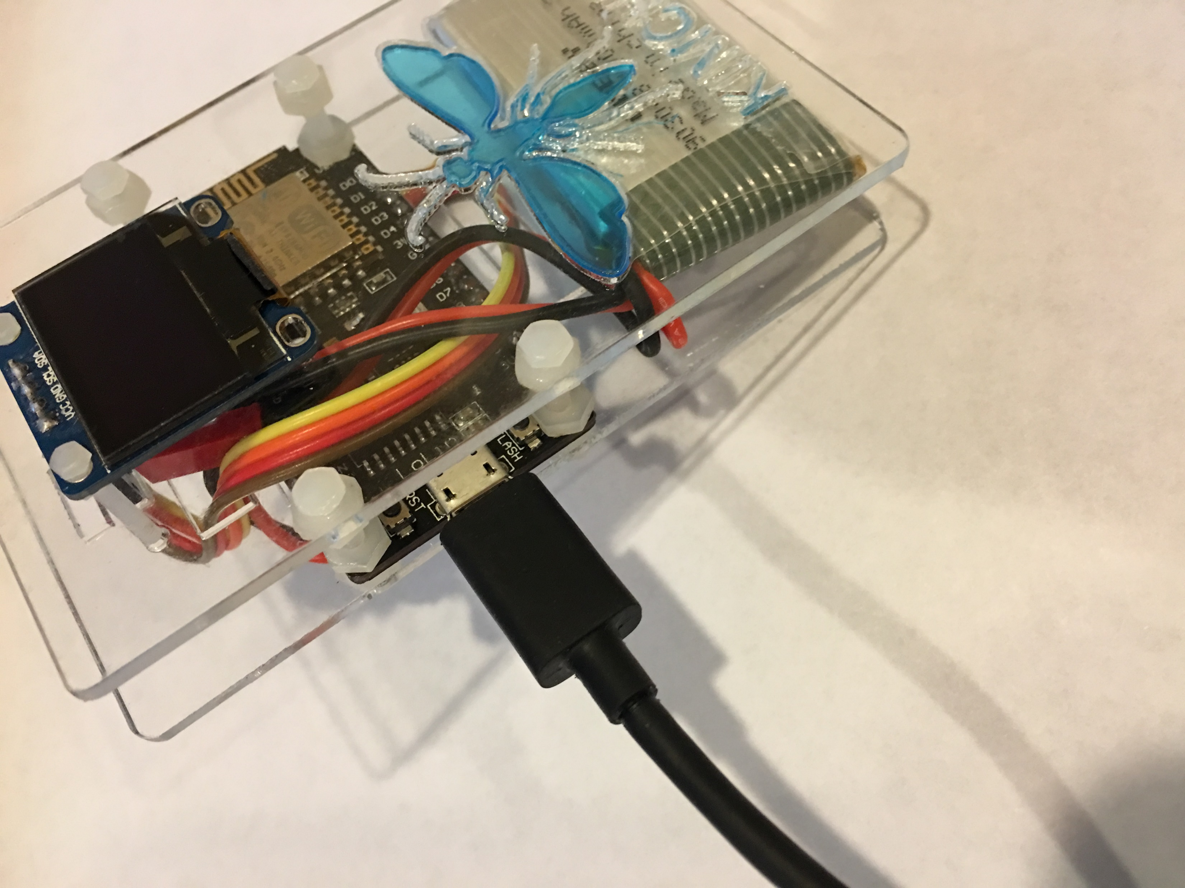
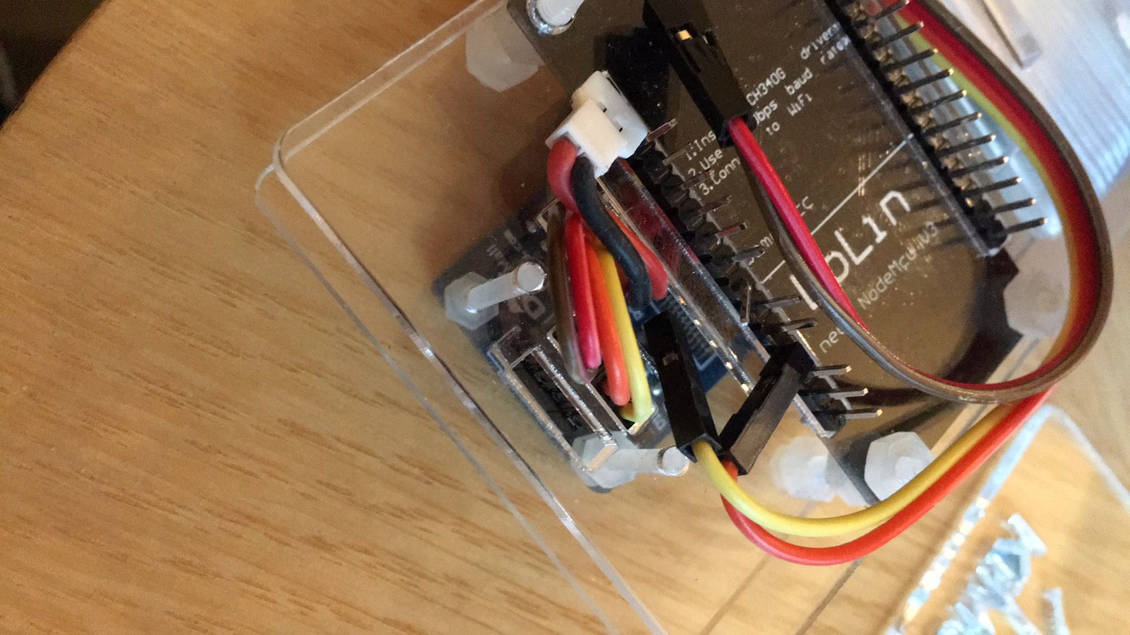
KimchiC0n 3 - DIY

Slide 25
KimchiC0n - DIY
https://github.com/kimchicon/Badge2017
Basic – 이름 보여주고, LED 빨/파/노 전환하기
https://github.com/kimchicon/Badge2017/blob/master/Basic/init.lua
오늘/내일 새로운 코드를 짜서 pull request 해주시길

Slide 26
OLED - 이름 표시 - i2c/u8g 모듈 사용
function init_i2c_display()
i2c.setup(0, 7, 5, i2c.SLOW)
disp = u8g.ssd1306_128x64_i2c(0x3c)
end
function draw()
disp:setFont(u8g.font_6x10)
disp:drawStr( 30, 10, "KimchiC0n 3")
disp:drawLine(0, 25, 128, 25);
disp:setFont(u8g.font_chikita)
disp:drawStr( 5, 40, "My name is Matt Oh")
end
i2c module - https://nodemcu.readthedocs.io/en/master/en/modules/i2c/
u8g module - https://nodemcu.readthedocs.io/en/master/en/modules/u8g/

Slide 27
LED Strip 제어 – ws2812 모듈
tmr.alarm(0, 200, 1, function()
if i%3==0 then
ws2812.write(string.char(255, 0, 0, 255, 0, 0, 255, 0, 0, 255, 0, 0, 255, 0, 0, 255, 0, 0, 255, 0, 0, 255, 0, 0))
end
if i%3==1 then
ws2812.write(string.char(0, 255, 0, 0, 255, 0, 0, 255, 0, 0, 255, 0, 0, 255, 0, 0, 255, 0, 0, 255, 0, 0, 255, 0))
end
if i%3==2 then
ws2812.write(string.char(0, 0, 255, 0, 0, 255, 0, 0, 255, 0, 0, 255, 0, 0, 255, 0, 0, 255, 0, 0, 255, 0, 0, 255))
end
i = i + 1
end)
→ https://nodemcu.readthedocs.io/en/master/en/modules/ws2812/

Slide 28
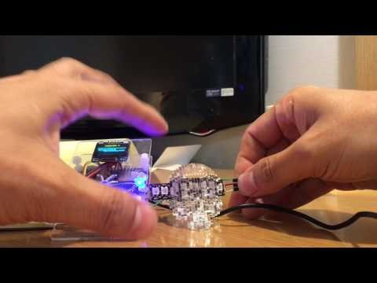
Badge + LED strip

